Slide 1
Intro to Node
and React
Front-End Web Development

Slide 2
node and npm
Intro to Node and React

Slide 3
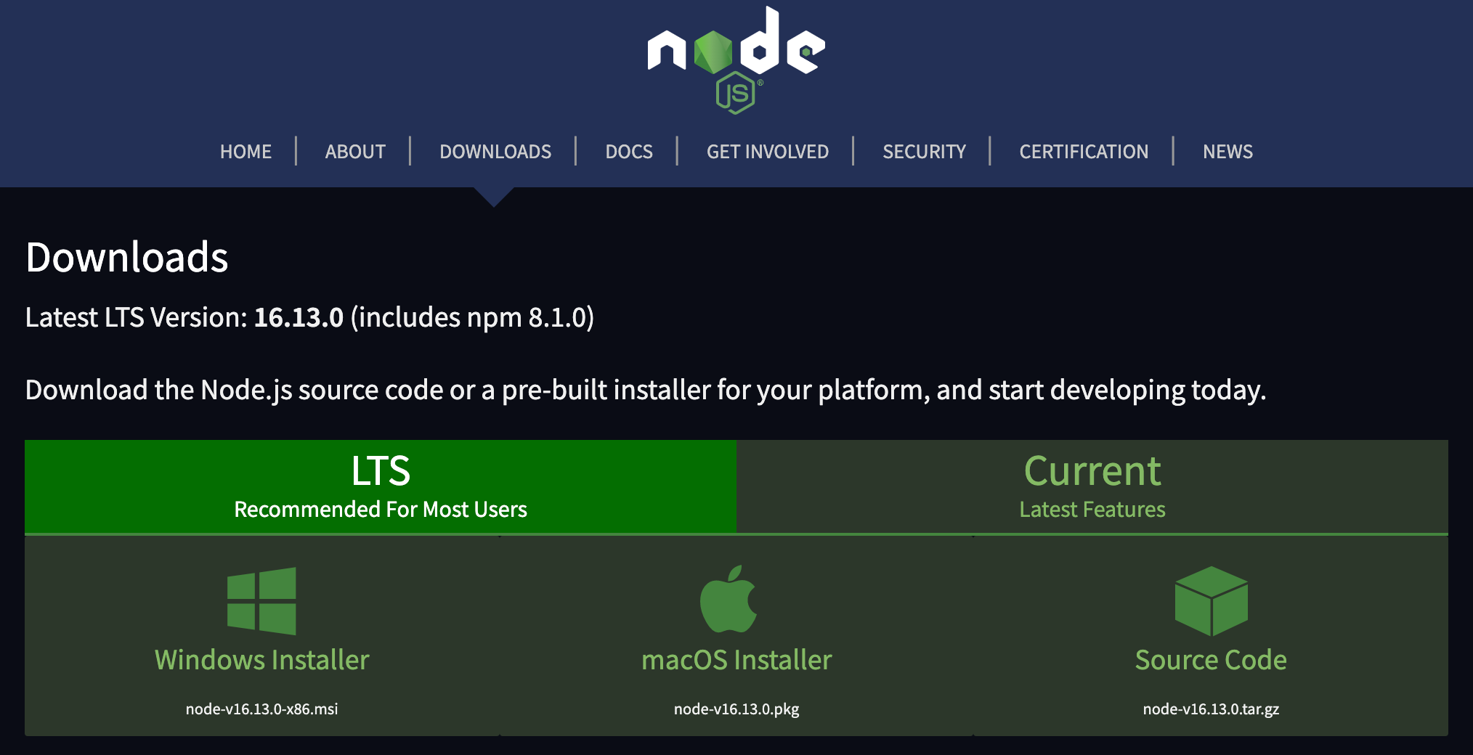
Node
Node.js® is a JavaScript runtime built on Chrome's V8 JavaScript engine.

Slide 4
Installing NVM, Node, and NPM on Windows
1
2
Download the windows installer from: https://github.com/coreybutler/nvm-windows/releases
Run in Terminal:
C:\> nvm install lts
Notes:
Windows:
https://github.com/coreybutler/nvm-windows/releases
MacOS vis Homebrew:
https://collabnix.com/how-to-install-and-configure-nvm-on-mac-os/

Slide 5
Installing NVM, Node, and NPM on MacOS
Open your terminal. You can search for it using spotlight if you are unsure of how to find it.
Installing Homebrew:
$ /bin/bash -c "$(curl -fsSL https://raw.githubusercontent.com/Homebrew/install/master/install.sh)"
Notes:
/bin/bash -c "$(curl -fsSL https://raw.githubusercontent.com/Homebrew/install/master/install.sh)"

Slide 6
Installing NVM, Node, and NPM on MacOS
Open your terminal. You can search for it using spotlight if you are unsure of how to find it.
$ brew update
$ brew install nvm
$ nvm install lts
This might take a min to update your homebrew software. Be patient, don’t close the window.
This should only take a min.
Notes:
Windows:
https://github.com/coreybutler/nvm-windows/releases
MacOS vis Homebrew:
https://collabnix.com/how-to-install-and-configure-nvm-on-mac-os/

Slide 7
What is LTS? (and why should we care)
Long
Term
Support
LTS versions of a technology will be maintained longer and usually are more stable

Slide 8
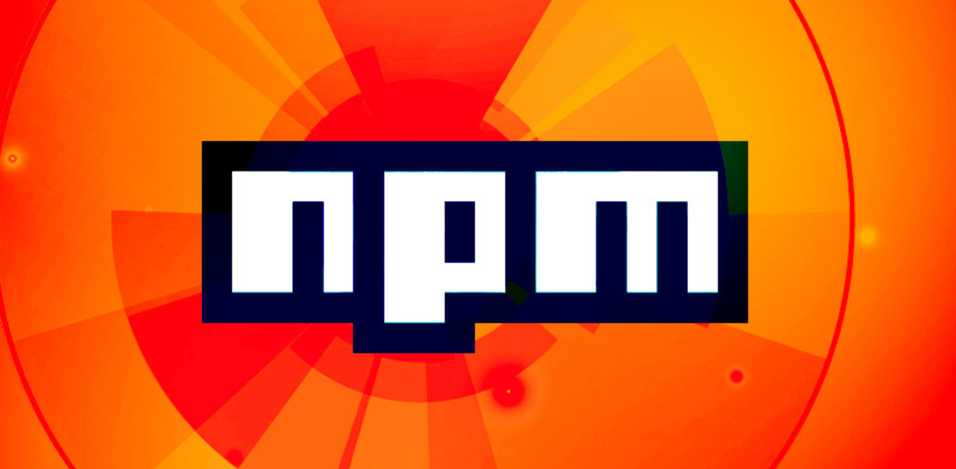
NPM
npm is a package manager for the JavaScript programming language maintained by npm, Inc. npm is the default package manager for the JavaScript runtime environment Node.js. It consists of a command line client, also called npm, and an online database of public and paid-for private packages, called the npm registry.

Slide 9
All together now
Mac - close and reopen your terminal window.
Windows - open cmd (search in start menu if you can’t find it)
$ node -v
$ npm -v
If the install was successful, this command will get you a node version printed to the console.
If the install was successful, this command will get you an npm version printed to the console.

Slide 10
Test Node
Create a new project folder on your desktop.
Create a new script.js file inside the project folder.
Add a console.log( “Testing node for the first time!” )
From your console window navigate into your project.
Run your js file with node:
$ node script.js

Slide 11
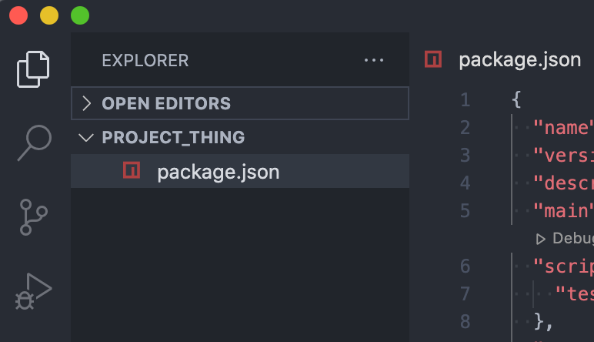
Test npm
From the console window, cd into your project folder
Type the command $ npm init this command will INITialize the node package manager and add a special file for tracking dependencies in your project folder.
Answer the prompts to create your first package.json file!

Slide 12
Demo: Add a package with npm
Let’s add a fun new package with npm:
url:
https://www.npmjs.com/package/colors

Slide 13
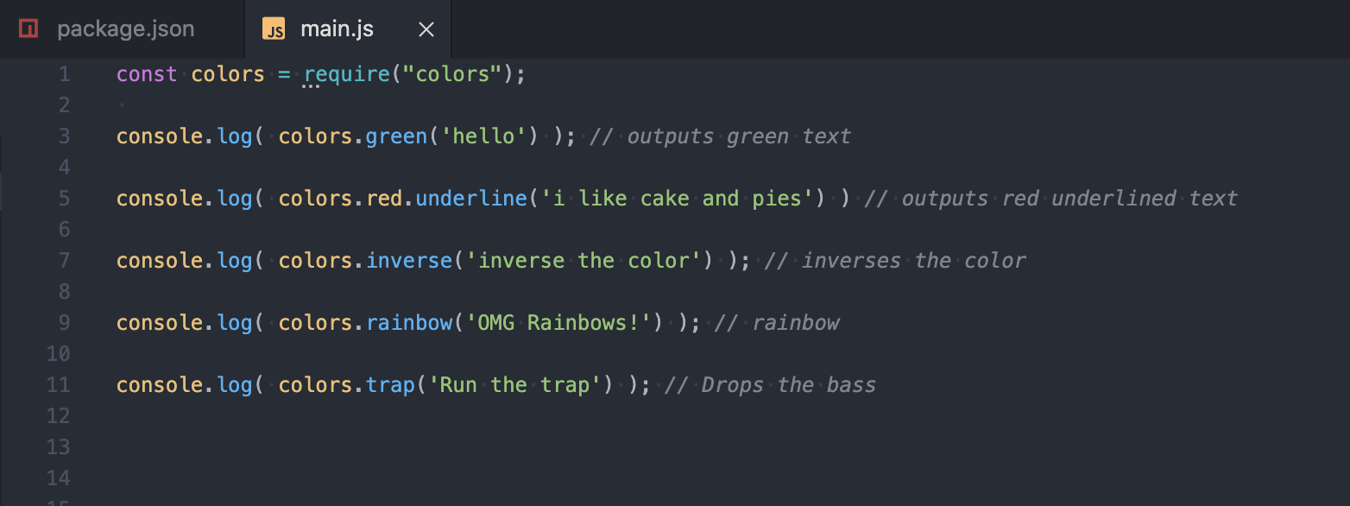
Demo Add a package
$ npm install -–save colors
Read the docs and take it for a spin!

Slide 14
node_modules
npm downloads all the code needed to make your fun new packages work and stores it all in a folder called node_modules.
As you can imagine, this file can get very large the more packages or dependencies your project uses.
Because they are so large, it is not best practice to commit them with git or push them to github. This can add thousands of files to your project and take forever to upload.
The solution: gitignore

Slide 15
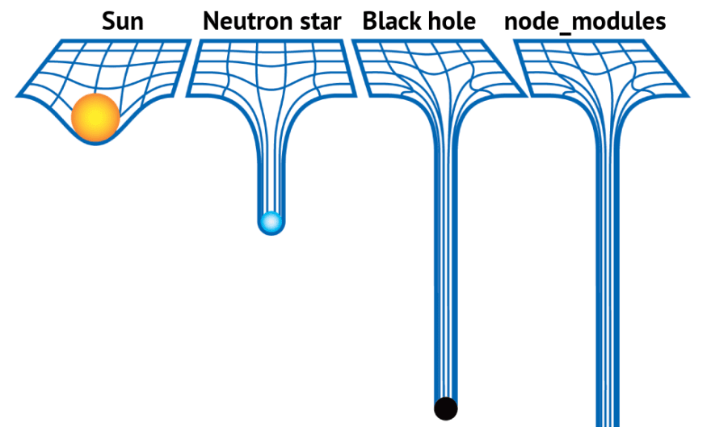

Slide 16
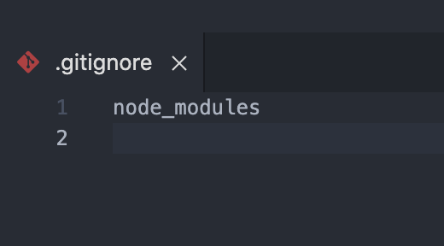
Gitignore
If you are using git to track changes in your project, you will need to create a file called a .gitignore.
As the name implies anything listed in the .gitignore is ignored when you commit your changes.
For this project all we need to list is the path to our node modules - they are in the same directory, so we just say “node_modules”
When creating a new project, always
do this step first so you don’t accidentally
make an initial commit with your
node modules.

Slide 17
Add a new package with npm
10 minutes
url:
https://www.npmjs.com/package/cow.io

Slide 18
Node Express
Express is a library that enables you to build a web server (back-end) using JavaScript
Using express you can have the server build:
HTML
An API

Slide 19
Anatomy of a Route
Method
Path
Param in Path
Input Request
Response
app.get('/api/:petType', function (req, res) {
let thePetType = req.params. petType || “dog”
res.json({“type”: thePetType, “food”:”Purina”})
})

Slide 20
99 Bottles of Beer
Create a node express application
When the user visits the site, they should see 99 bottles of beer on the wall
See the readme.md for more details

Slide 21
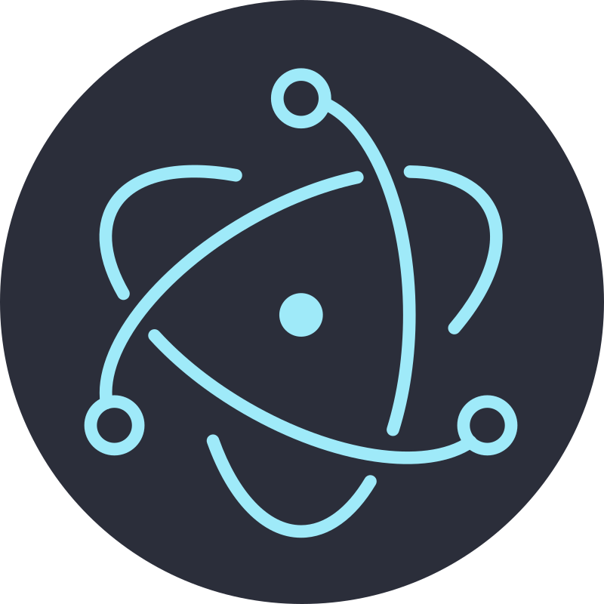
Electron

